Slide 1
DAt504 Advanced Web Technologies
Group 5 –
Rhys Baker – Thomas Kerslake – Sidney Kingsley – Damian Zając – Lei Zhou

Slide 2
Project Plan
Our Roles within the group
Rhys, Thomas and Sidney – To develop the application using Node.js, Express and a MongoDB.
Everyone – Create a Professional design and user experience.
Everyone– To create and develop concepts.
Lei and Damian – Research competitors.

Slide 3
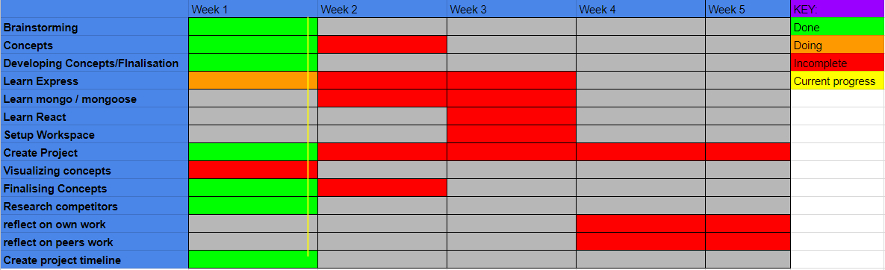
Gantt Chart And Meetings
Thomas and Rhys created the Gantt chart so that we knew what had to be done and keep on a schedule to ensure that the project is ready. We can also use the Gannt chart to reflect on and decide if we need to extend certain tasks.

Slide 4
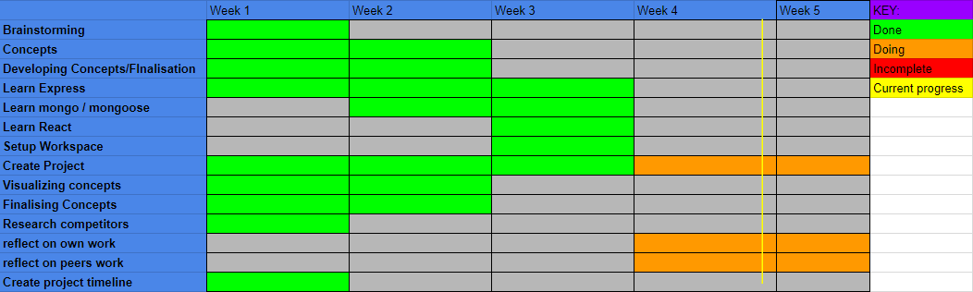
Gantt Chart And Meetings
To make sure that everyone knows what had to be done we would meet up at the beginning of the week and assign tasks to each member of the group which they could complete that week and show their progress in the following meeting.

Slide 5
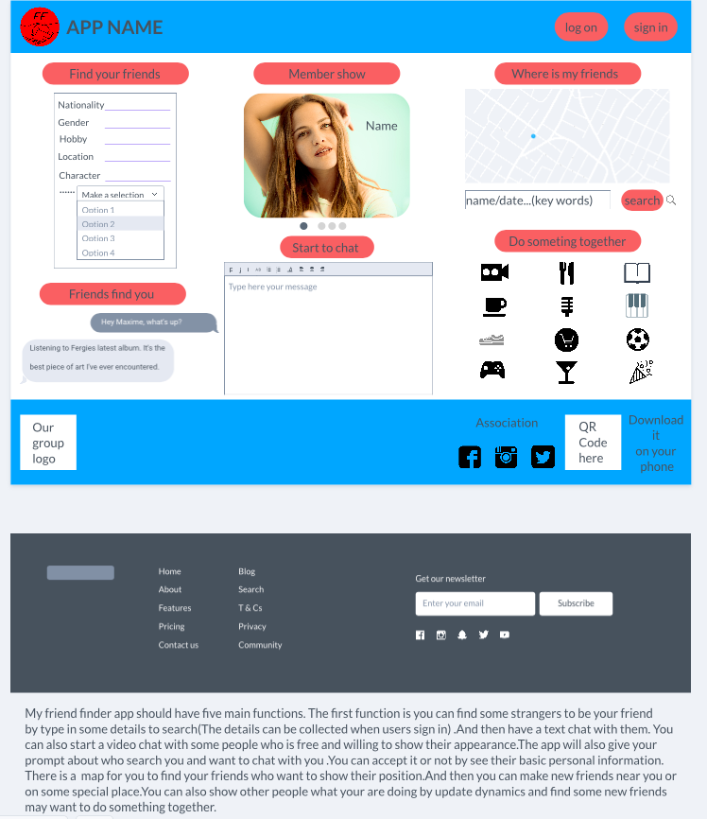
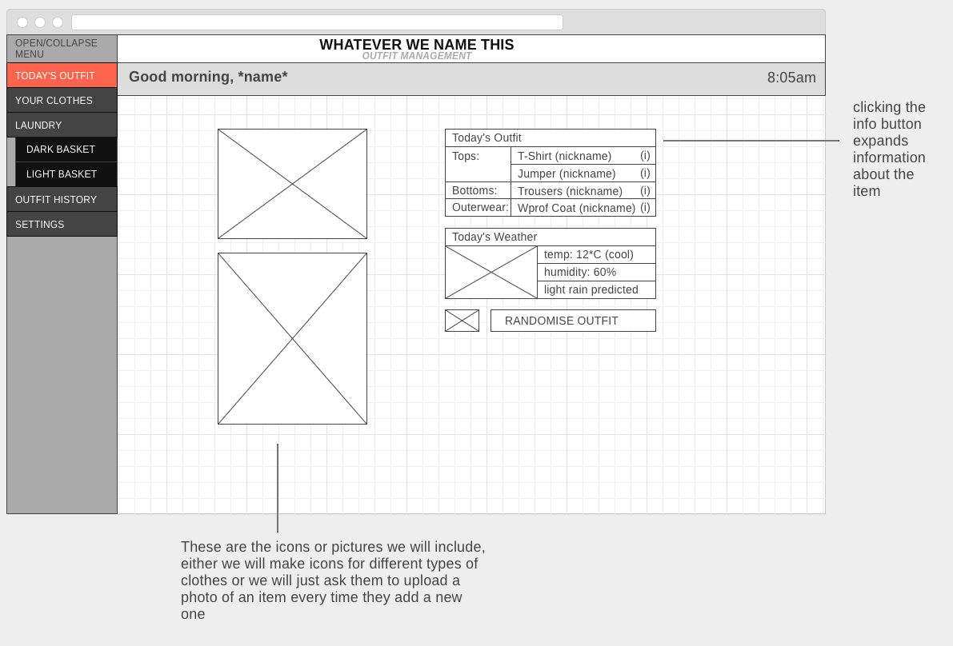
Concept And Context
After meeting up for the first time we decided that we were to all create and idea and develop it and present to the group the following Monday.

Slide 6
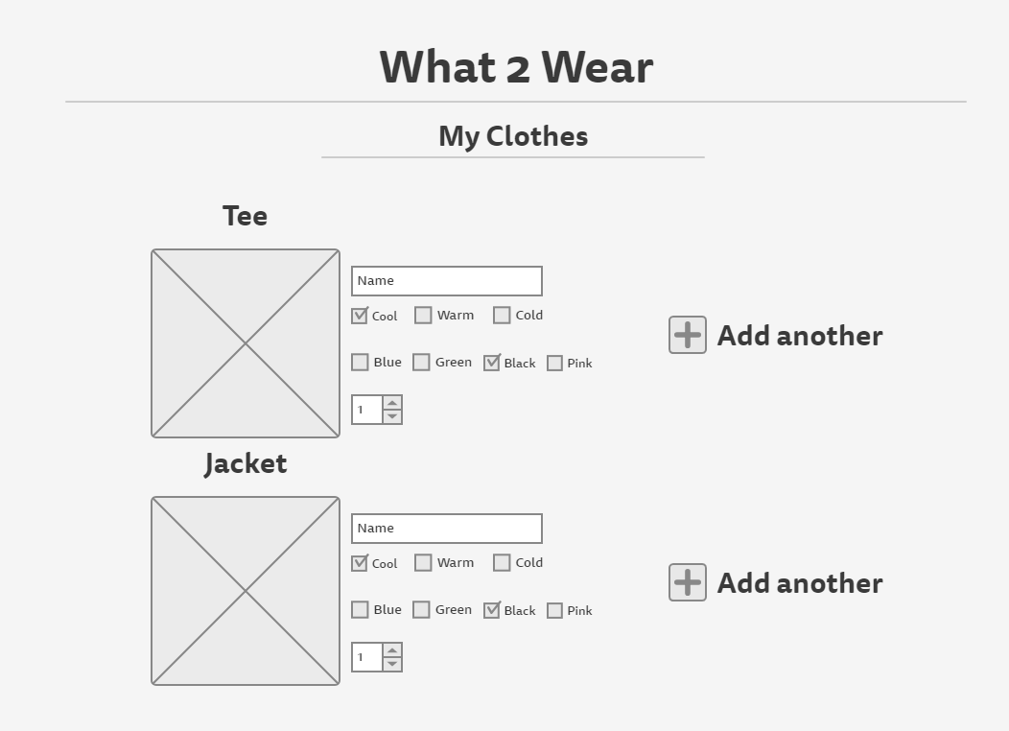
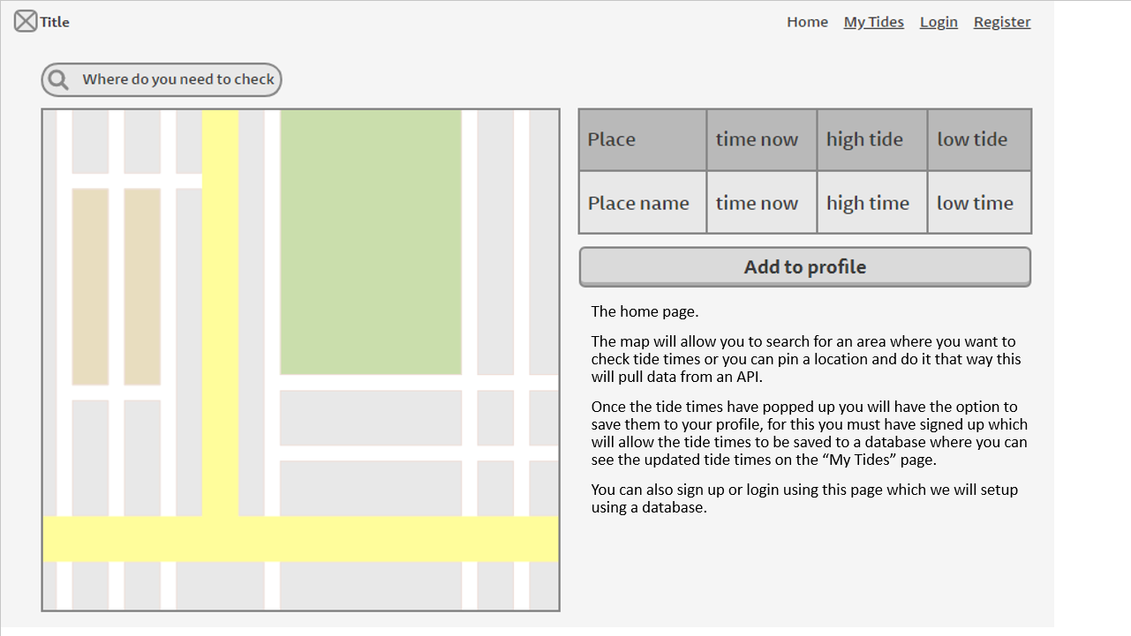
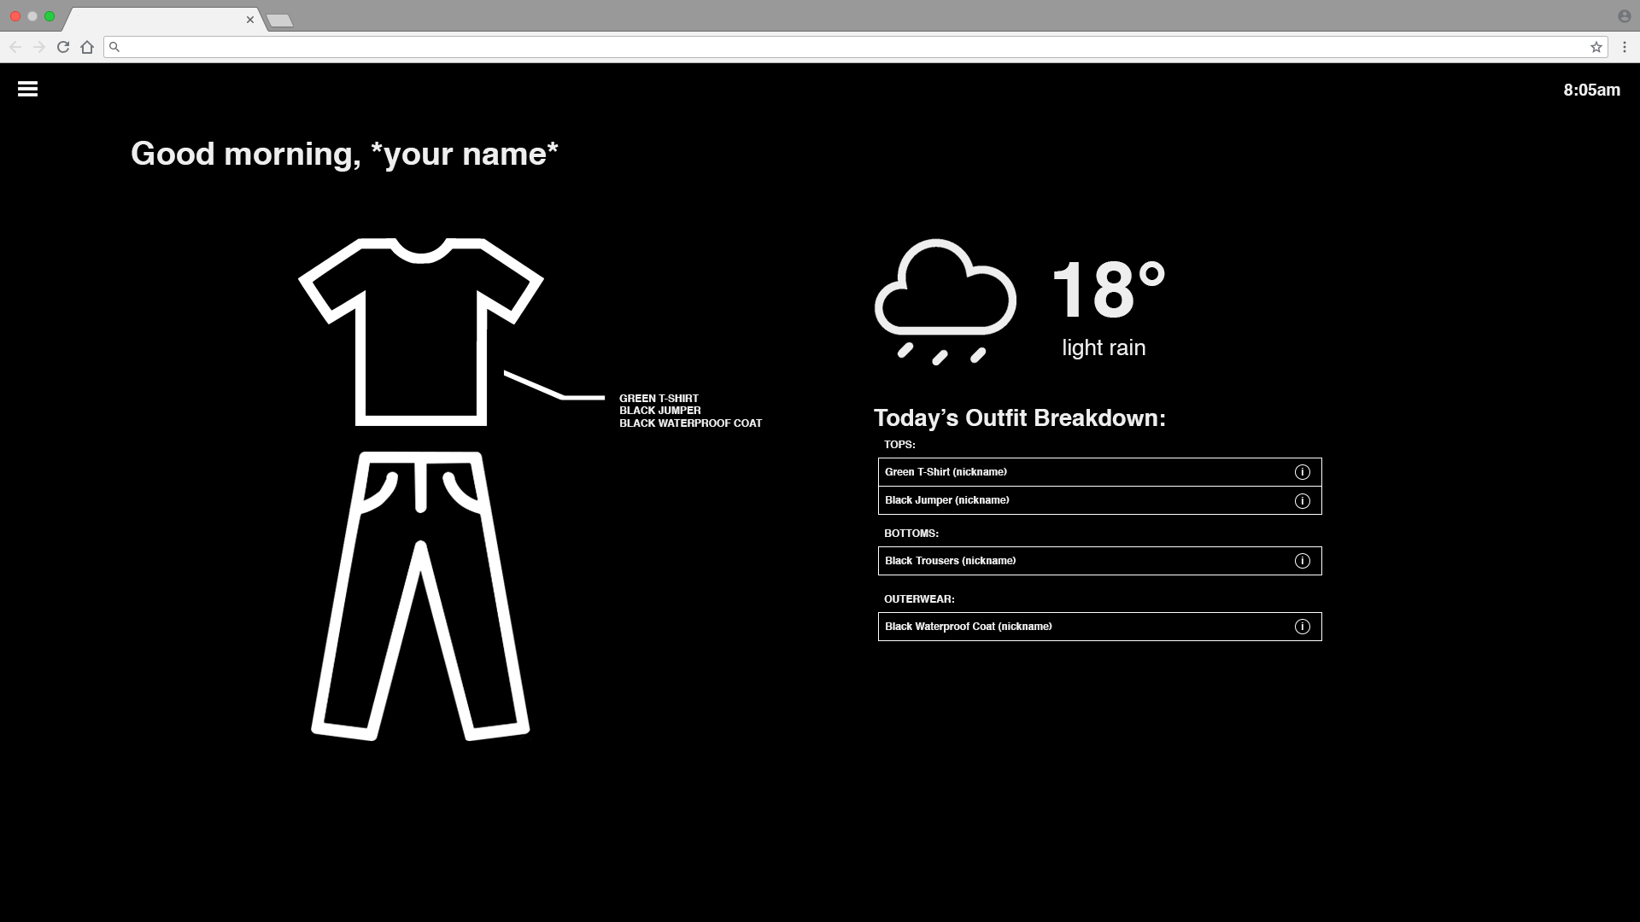
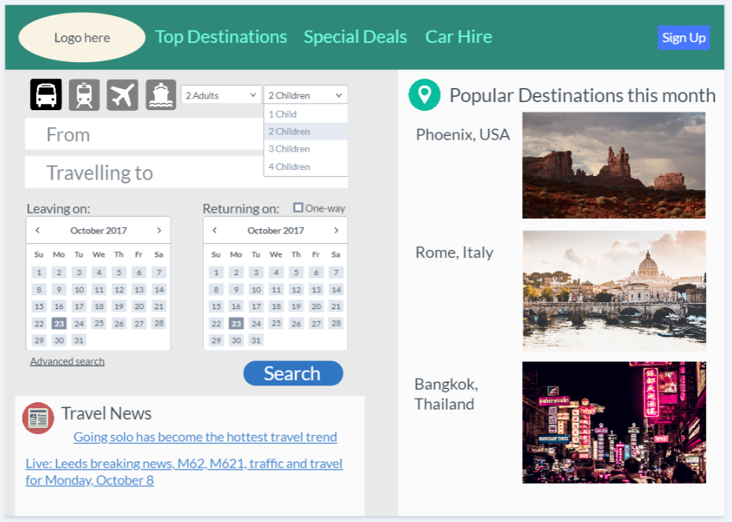
Concept And Context

Slide 7





Design - Icons

Slide 8



Design - Logos
After Finalising our idea we decided it would be best to start developing assets for our website.

Slide 9

Final Logo Design

Slide 10
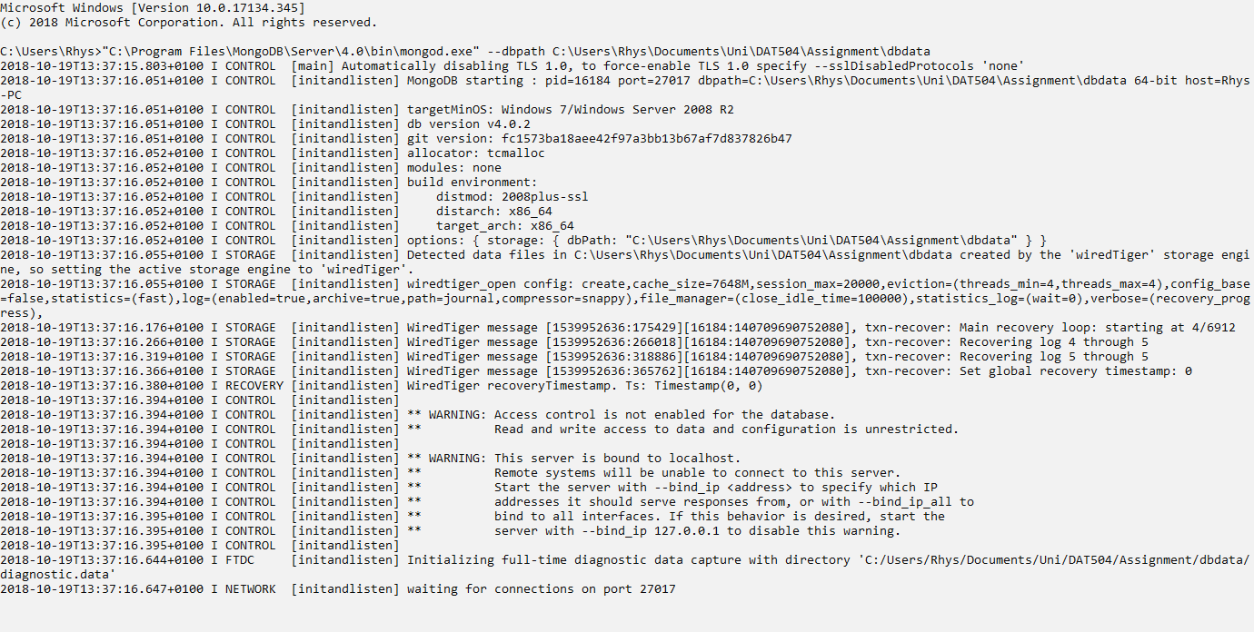
Application

Slide 11
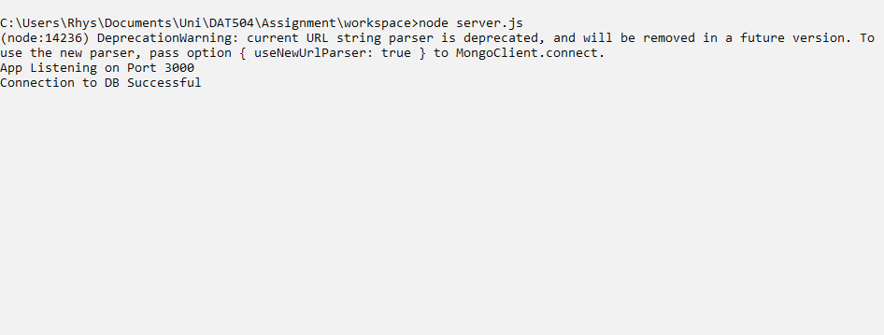
Application

Slide 12
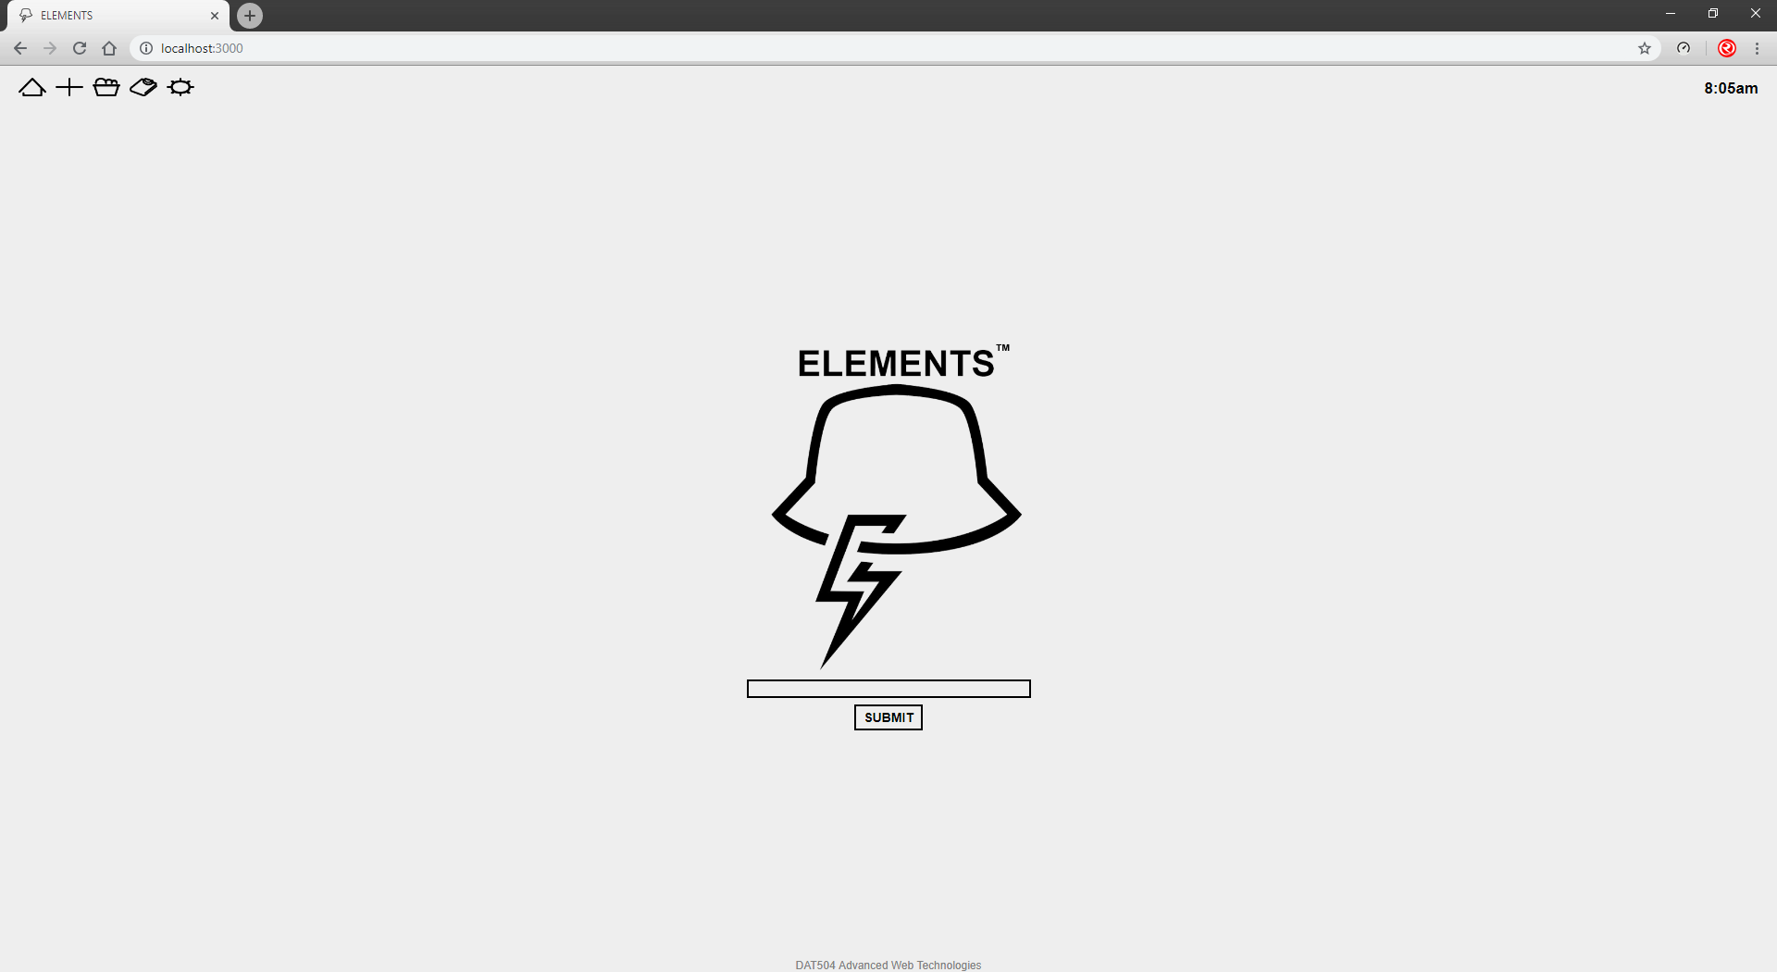
Application

Slide 13
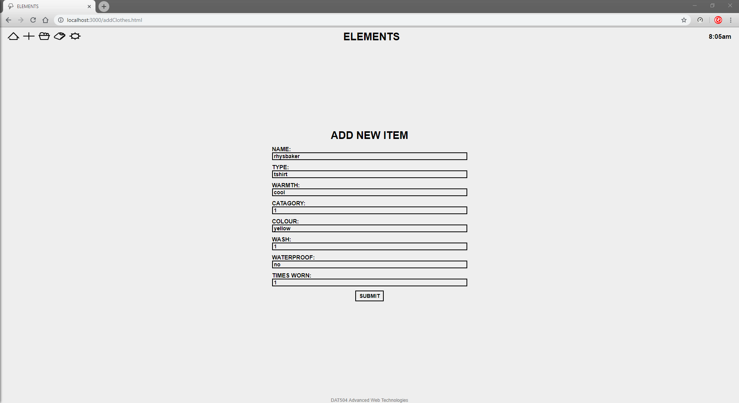
Application

Slide 14
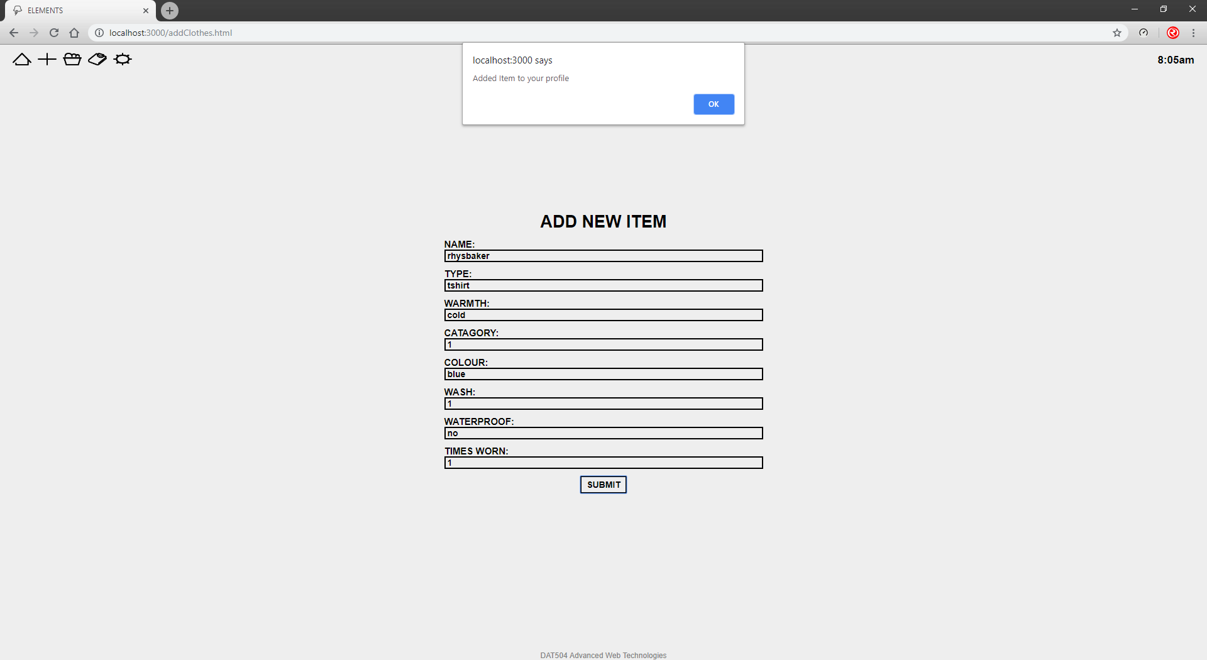
Application

Slide 15
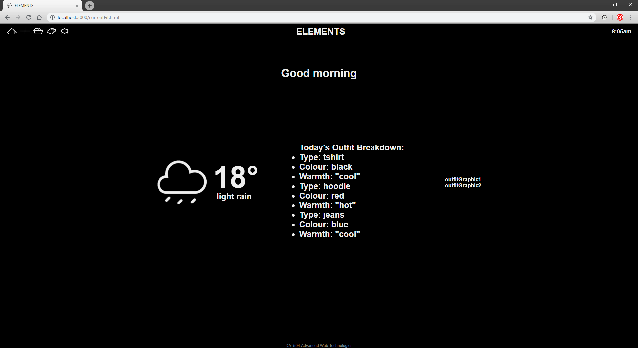
Application

